Slide 1

Which Hadoop Distribution to Choose

Slide 2





What will you learn today?
Introduction to Apache Hadoop
Various Hadoop Distributions
Cloudera Hadoop Distribution
A closer look at Hortonworks and MapR
How to choose a Hadoop Distribution

Slide 3

Where it all started – Apache Hadoop
The Apache Hadoop is an open source framework that allows distributed processing of large data sets across clusters of computers
Hadoop introduced a new way to simplify the analysis of large data sets, and in a very short time reshaped the big data market and have become the synonym for big data

Slide 4
A closer look at Apache Hadoop
Apache Hadoop includes following modules :
Hadoop Distributed File System (HDFS): A distributed file system that provides access to application data
Hadoop Common: The common utilities that support the other Hadoop modules
Hadoop YARN: A framework for job scheduling and cluster resource management
Hadoop MapReduce: A YARN-based system for parallel processing of large data sets

Slide 5
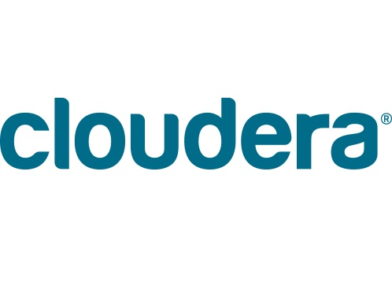


Popular Hadoop Distributions

Slide 6
Popular Hadoop Distributions - Cloudera
Founded by a group of engineers from Yahoo, Google and Facebook Cloudera ranks top in the big data vendors list for making Hadoop a reliable platform for business use since 2008

Slide 7
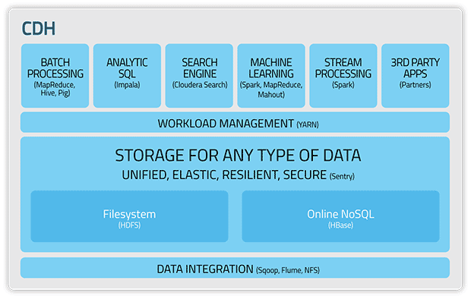
A closer look at Cloudera - CDH
Cloudera Hadoop (CDH) - CDH includes the core elements of Hadoop along with additional components such as a user interface, security, and integration with a broad range of hardware and software

Slide 8
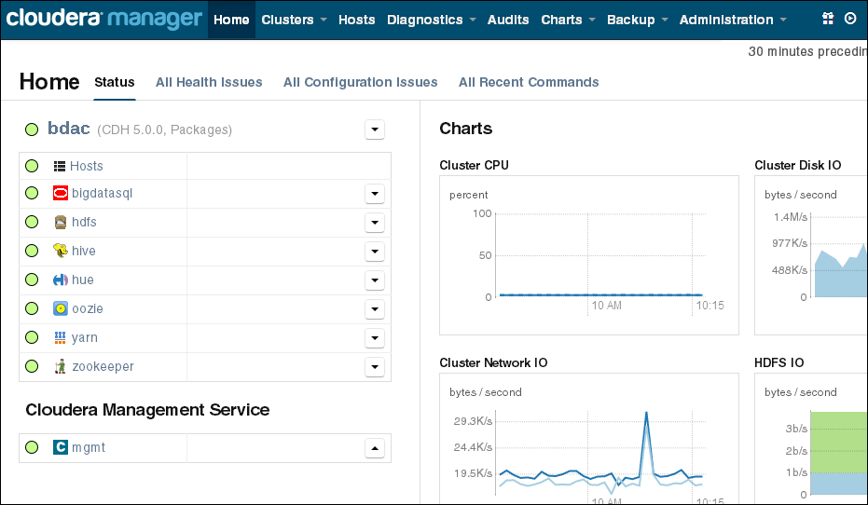
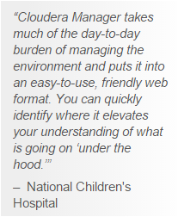
A closer look at Cloudera – Cloudera Manager
Cloudera Manager makes administration of your enterprise data hub simple and straightforward, at any scale. With Cloudera Manager, you can easily deploy and centrally operate the complete Big Data stack

Slide 9
A closer look at Cloudera – Other Products
Cloudera Express - Cloudera Express is a free download that combines CDH with Cloudera Manager, which provides robust cluster management capabilities like automated deployment, centralized administration, monitoring, and diagnostic tools
Cloudera Enterprise - Cloudera Enterprise includes CDH with advanced system management and data management tools plus dedicated support from Cloudera
Cloudera Director - Cloudera Director extends Cloudera's enterprise data hub architecture to the cloud, without compromising on security, management, and governance

Slide 10
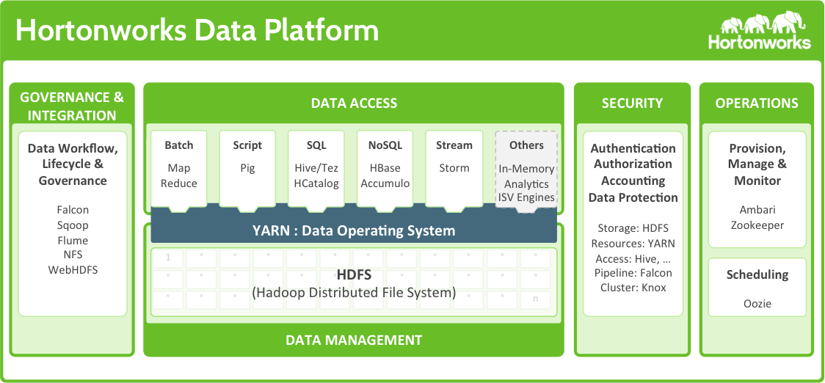
Popular Hadoop Distributions - Hortonworks
Founded in 2011, Hortonworks has quickly emerged as one of the leading vendors of Hadoop
Hortonworks Data Platform

Slide 11
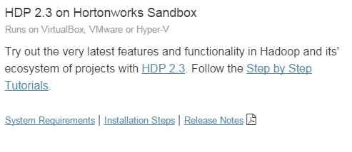
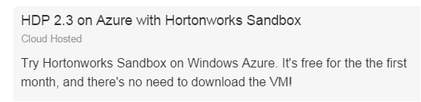

Hortonworks Sandbox
Hortonworks Sandbox lets you get started with Hortonworks Data Platform (HDP) . You can run Hortonworks Sandbox either in the cloud or on your personal machine.
Hortonworks Sandbox on a VM
Hortonworks Sandbox in the Cloud

Slide 12
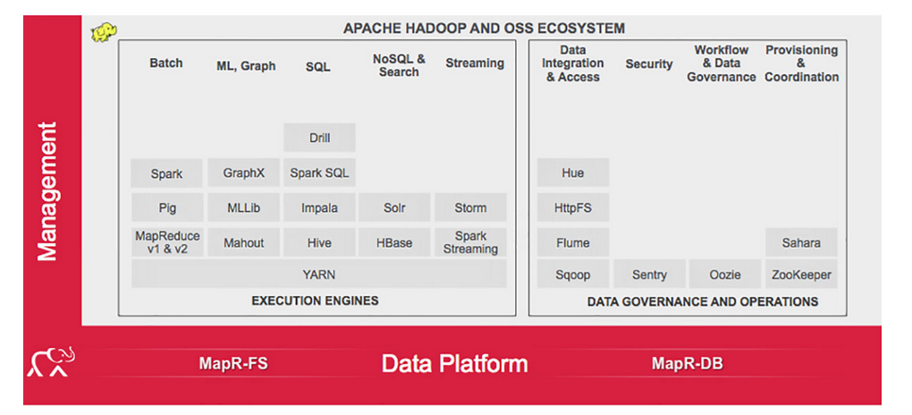
Popular Hadoop Distributions - MapR
Compared to other Hadoop distributions e.g. Cloudera and Hortonworks, MapR takes a different approach as it uses its own proprietary file system MapRFS
MapR Data Platform

Slide 13
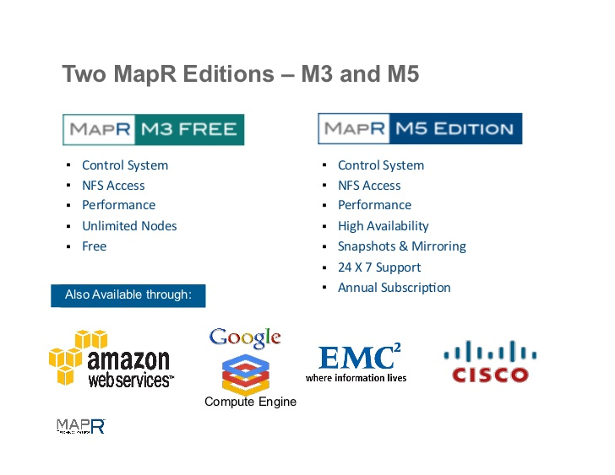
MapR Products

Slide 14
Which one to choose ?

Slide 15
Which one to choose ?
Before selecting the Hadoop Distribution ask yourself which problems you are trying to solve and what all features you need

Slide 16



Choosing a Hadoop Distribution
If you are looking for complete Hadoop stack with all features, then MapR is the way to go.
But note that MapR enterprise edition is not free and takes a different approach than Apache Hadoop

Slide 17

Choosing a Hadoop Distribution
If you are looking for complete Hadoop stack with all features, then MapR is the way to go.
But note that MapR enterprise edition is not free and takes a different approach than Apache Hadoop
Cloudera is based on 100% open source Apache Hadoop and has added its own proprietary tools
Similar to MapR, Cloudera also provides both free and paid distribution with extra features and support

Slide 18
Choosing a Hadoop Distribution
Social
xyz
If you are looking for complete Hadoop stack with all features, then MapR is the way to go.
But note that MapR enterprise edition is not free and takes a different approach than Apache Hadoop
Cloudera is based on open source Apache Hadoop but has added its own proprietary tools.
Similar to MapR, Cloudera also provides both free and paid distribution with extra features and support
Hortonworks is the only commercial vendor to provide complete open source Hadoop.
Hortonworks intentionally not developed proprietary software and uses open source softwares e.g. Ambari, Stinger and Solr
Key point in Economical
Key point in Social

Slide 19
Why not try them all ?
All Hadoop Distribution vendors provide free (community edition) version, its not a bad idea to try them all and get an idea how each one of them is different from others

Slide 20
Survey
Your feedback is vital for us, be it a compliment, a suggestion or a complaint. It helps us to make your experience better! Please spare few minutes to take the survey after the webinar.

Slide 21
Thank You …
Questions/Queries/Feedback
Recording and presentation will be made available to you within 24 hours

